Slide 1
K-Means, GMM and KNN

Slide 2
Agenda
Classification and Suitable ML Methods
Binary Classification
Multiclass Classification
Multilabel Classification
Multioutput Classification
Distance Metrics
K-Nearest Neighbor
Clustering
K-Means
DBSCAN
Gaussian Mixture Models

Slide 3
Classification vs Regression
Classification: Resp. variable is categorical
Regression: Resp. variable is numerical
We can use regression models for classification tasks (e.g.: Logistic/Softmax Regression)
To use classification models for regression tasks, we need to use class probabilities or numerical values that belong to class members
The two terms are used interchangeably, but we need to remember the difference under the hood

Slide 4
Types of Classifications
Binary Classification
Binary classes/categories (0 or 1)
Usually the probability of the positive class will suffice for the task
Multiclass Classification
Multinomial classes/categories (can be anything)
Usually one probability per each class
Strategy
OneVsRest(OvR): one classifier for all classes
OneVsOne (OvO): one binary classifier per each pair of classes (a lot more training!)
Multilabel Classification
Classify into one label per each instance (e.g.: recognizing multiple faces per each photo)
Each label is comprised of multiple binary classes
Strategy: individual binary classification per each element of the label
Multioutput Classification (not common & ok if not known)
Generalization of the multilabel classification (e.g.: image denoise)
Each Label is comprised of multiple multinomial classes
Strategy: individual multiclass classification per each element of the label

Slide 5
Typical Methods for Binary Classification
Logistic Regression
SVM
Naïve Bayes
Decision Tree/Random Forests/Gradient Boosting
Multilayer Perceptron (aka, neural network)

Slide 6
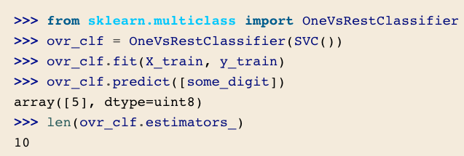

OvR vs OvO
OvR (default for binary classification):
Pro: one model for all classes
Con: scalability & class imbalance
Typical methods:
KNN
Naïve Bayes
Random Forests (can be both but OvR by default)
Neural Networks
OvO:
Pro: less data to train on per each classifier & scales well
Con: much more models to train/tune: $\frac{N ×\left(N −1\right)}{2}$ binary classifiers!
Typical Methods:
SVM
Boosting for multiclass classification are done differently by different people/package

Slide 7

Distance Metrics
Euclidian (${\left(x_{i} −y_{i}\right)}^{2}$)/Manhattan ($|x_{i}−y_{i}|$) Distance: measures 3-D distance
Minkowski Distance: measures N-D distance
Cosine Distance: measures distance b/w embeddings
See SimilarityBased.ipynb for more details

Slide 8
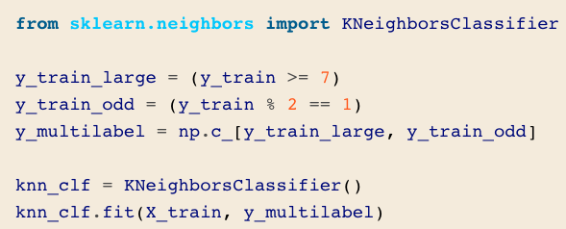
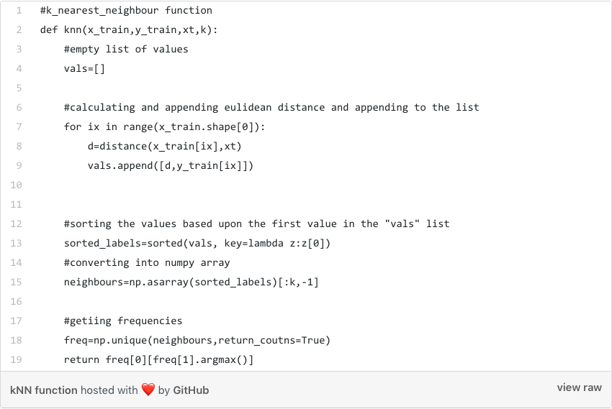
K-Nearest Neighbor: Classify Instances Based on Distances
If k = 3, red dot will be classified as purple
If k = 6, red dot will be classified as yellow
Key Benefit: NO TRAINING NEEDED!
STEPS FOR PREDICTION
Receive an unclassified data;
Measure the distance (Euclidian, Manhattan, Minkowski or Weighted) from the new data to all others data that is already classified;
Gets the K(K is a parameter that you define) smaller distances (default = 5 for sklearn);
Check the list of classes had the shortest distance and count the amount of each class that appears;
Takes as correct class the class that appeared the most times;
Classifies the new data with the class that you took in step 5;
Source:
https://towardsdatascience.com/knn-k-nearest-neighbors-1-a4707b24bd1d
https://medium.com/machinelearningalgorithms/k-nearest-neighbors-c9823dca611b
https://medium.com/@chiragsehra42/k-nearest-neighbors-explained-easily-c26706aa5c7f

Slide 9
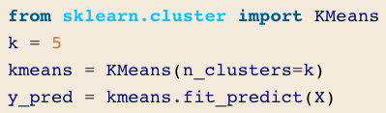
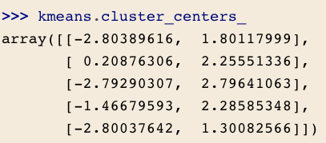
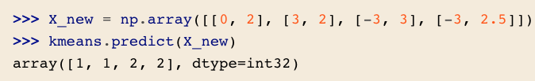
K-Means
Fast and efficient clustering
Sometimes called Lloyd–Forgy
K-Means++
smarter initialization
Mini-batch K-Means
Use a portion of the full dataset at each iteration
Able to cluster large dataset

Slide 10
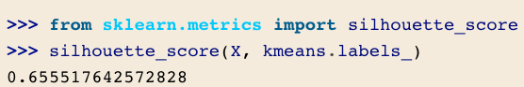
Finding Optimal Clusters
Mostly trial-and-error
A precise and expensive approach is by using silhouette score
The larger the better

Slide 11
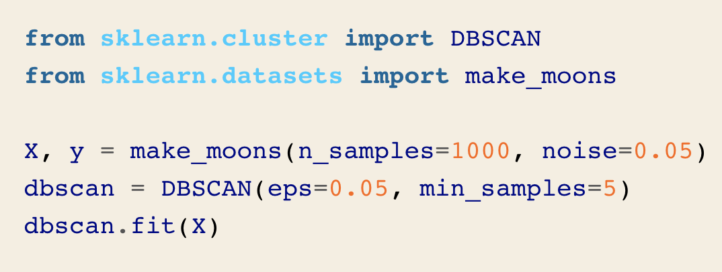
DBSCAN
counts how many instances are located within a small distance ε
an instance has at least min_samples instances in its ε-neighborhood (including itself), then it is considered a core instance
All instances in the neighborhood of a core instance belong to the same cluster
Any instance that is not a core instance and does not have one in its neighborhood is considered an anomaly

Slide 12
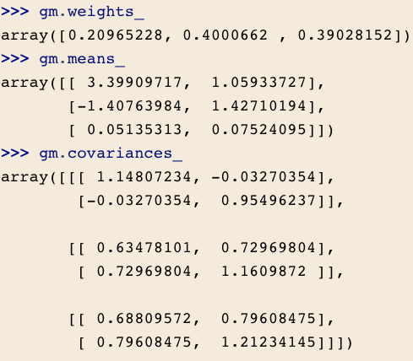
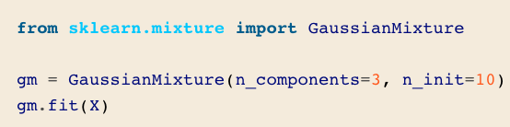
Gaussian Mixture Model
Main disadvantage of K-Means: no probability/confidence!
GMM instead models the data by multiple Gaussian distributions
Strategy: given a data point x, what is the probability it came from Gaussian k?
For each instance, a cluster is picked randomly from among k clusters.
The probability of choosing the j^{th} cluster is defined by the cluster’s weight, ϕ^{(j)}.
The index of the cluster chosen for the i^{th} instance is noted z^{(i)}.
If z^{(i)}=j, meaning the i^{th} instance has been assigned to the j^{th} cluster, the location x^{(i)} of this instance is sampled randomly from the Gaussian distribution with mean μ^{(j)} and covariance matrix Σ^{(j)}.
This is noted x(i)∼𝒩(μ(j),Σ(j))x(i)∼𝒩(μ(j),Σ(j)).
Source:
https://towardsdatascience.com/gaussian-mixture-models-explained-6986aaf5a95

Slide 13
Active Learning
Uncertainty Sampling
Human experts interact with the learning algorithm
Provide labels for specific instances when the algorithm requests them
Strategies:
Uncertainty Sampling
Largest model change
Largest drop in the model’s validation error
Instances that different models disagree
The model is trained on the labeled instances gathered so far, and this model is used to make predictions on all the unlabeled instances.
The instances for which the model is most uncertain (i.e., when its estimated probability is lowest) are given to the expert to be labeled.
You iterate this process until the performance improvement stops being worth the labeling effort.

Slide 14
Further Reading
Variational Bayesian: http://www.tamarabroderick.com/tutorial_2018_icml.html
GMM: https://towardsdatascience.com/gaussian-mixture-models-explained-6986aaf5a95

